Slide 1


Why Paying for Storage Beats Free Networking in Cloud Bursting
Itamar Gefen Aviad Zuck Daniel Bransky
Moshik Hershcovitch Danny Harnik Dan Tsafrir
Notes:
Hi everyone, happy to be here, my name is itamar, im a MSC student at the technion in israel. I am going to present you our work "Why Paying for Storage Beats Free Networking in Cloud Bursting"

Slide 2
Cloud Bursting
on-prem datacenter
Job 1
Job 2
Job 3
Job 4
Notes:
To get started, lets first quickly explain what cloud bursting is.
So lets say we have an organization, and our organization have a private datacenter.

Slide 3
Cloud Bursting
Problem
on-prem datacenter
Job 1
Job 5
Job 2
Job 6
Job 3
Job 7
Job 4
not enough on-prem resources
Notes:
Now for some reason, for example lack of resources, we may need to offload jobs to the public cloud

Slide 4



Cloud Bursting
Solution
on-prem datacenter
public cloud
Job 1
Job 2
inter-cloud network
Job 5
Job 3
Job 6
Job 4
Job 7
flexibility, scalability
pay-per-use pricing!
Notes:
Or in other words, burst into the public cloud.
We should mention that cloud resources are charged per use – what that means is that for example CPU is priced per time of use, and storage priced per GB per storage time, and so on.
SO in general, cloud provides flexibility regarding to their computing resources management and scalability while being cost effective.

Slide 5

Storage Access
on-prem datacenter
public cloud
inter-cloud network
Job 5
Obj 1
Notes:
Now, Jobs that are offloaded to the cloud may need to access on-prem storage

Slide 6
Storage Access
on-prem datacenter
public cloud
inter-cloud network
Job 5
Obj 1
Obj 1
Incoming network is free
Notes:
Such access are performed over an inter-cloud network link. However, cloud providers don’t charge for incoming network
That’s because they want to encourage users to move data into their cloud

Slide 7
Storage Access
on-prem datacenter
public cloud
inter-cloud network
Job 5
Obj 1
Obj 1

Slide 8
Common Practice
Store On-Prem, Repeatedly Transfer to the Cloud
on-prem datacenter
public cloud
time t1:
inter-cloud network
Job 5
Obj 1
Notes:
As a result, according to information we got from IBM storage experts, the common practice is to store the data on-prem and repeatedly read it in the cloud

Slide 9
Common Practice
Store On-Prem, Repeatedly Transfer to the Cloud
on-prem datacenter
public cloud
time t1:
inter-cloud network
Job 5
Obj 1
Obj 1
Notes:
So if a job needs the same object on time t1 and then again on time t2, it would be read remotely on both times

Slide 10
Common Practice
Store On-Prem, Repeatedly Transfer to the Cloud
on-prem datacenter
public cloud
time t1:
inter-cloud network
Job 5
Obj 1
Obj 1
Notes:
So if a job needs the same object on time t1 and then again on time t2, it would be read remotely on both times

Slide 11
Common Practice
Store On-Prem, Repeatedly Transfer to the Cloud
on-prem datacenter
public cloud
time t1:
inter-cloud network
Job 5
Obj 1
Notes:
So if a job needs the same object on time t1 and then again on time t2, it would be read remotely on both times

Slide 12
Common Practice
Store On-Prem, Repeatedly Transfer to the Cloud
on-prem datacenter
public cloud
time t1:
inter-cloud network
Job 5
Obj 1
on-prem datacenter
public cloud
time t2:
inter-cloud network
Job 5
Obj 1
Notes:
So if a job needs the same object on time t1 and then again on time t2, it would be read remotely on both times

Slide 13
Common Practice
Store On-Prem, Repeatedly Transfer to the Cloud
on-prem datacenter
public cloud
time t1:
inter-cloud network
Job 5
Obj 1
on-prem datacenter
public cloud
time t2:
inter-cloud network
Job 5
Obj 1
Obj 1
Notes:
So if a job needs the same object on time t1 and then again on time t2, it would be read remotely on both times

Slide 14
Common Practice
Store On-Prem, Repeatedly Transfer to the Cloud
on-prem datacenter
public cloud
time t1:
inter-cloud network
Job 5
Obj 1
on-prem datacenter
public cloud
time t2:
inter-cloud network
Job 5
Obj 1
Obj 1
Notes:
So if a job needs the same object on time t1 and then again on time t2, it would be read remotely on both times

Slide 15

Problem: Slow Inter-cloud Network
on-prem datacenter
public cloud
time t1:
inter-cloud network
Job 5
Obj 1
Obj 1
50ms
time-to-first byte
on-prem datacenter
public cloud
pay-per-use pricing!
time t2:
inter-cloud network
Job 5
Obj 1
Obj 1
Notes:
Now, the inter-cloud network link is slow. Exactly how slow is dependent on the exact setup, but nevertheless it is several times slower the latency and throughput inside the cloud.
This can increase the job execution time.
And if you recall, the CPU in the cloud is charged per time of use.

Slide 16


Observation
Notes:
So this leads us to our observation, that time=money. What I mean is that reading objects remotely, even though its not charged directly, cost money – due to the delay it causes

Slide 17

Caching at the Cloud
Obj 1 is 500KB => COST (inter-cloud network delay) == cache Obj 1 for ~5 days
Notes:
What can we do about it? Well, cache.
It turns out actually, that if OBJ 1 size is 500k, at the same CPU cost for the time it takes to read it remotely, we could store it in cloud object storage for ~5 days.

Slide 18







Caching at The Cloud
on-prem datacenter
public cloud
time t1:
Job 5
inter-cloud network
Obj 1
Obj 1
obj storage
on-prem datacenter
public cloud
time t2:
Job 5
storage cost
inter-cloud network
CPU cost
Obj 1
50ms
time-to-first byte
Obj 1
10ms
obj storage
Notes:
So how will that look with caching? - on time t1 the object will be read remotely, and will be stored in the cache.
And on time t2 the object will be read locally from the cache. So this can save on CPU cost, if the job runs faster, but on the other hand introduces new storage cost for the cache

Slide 19
Question:
can paying for storage beat free
networking in cloud bursting?
Notes:
So now we need to evaluate if Paying for Storage Beat Free Networking in Cloud Bursting

Slide 20
Methodology
Simulate ~100 SNIA IBM Cloud Traces
Trace 1:
Obj 0 read at t=13
Obj 1 read at t=100
Obj 0 read at t=170
Obj 2 read at t=400
...
Notes:
We used one week long real-world object storage traces collected by IBM, and used for simulation with two modes:
A) the first represent io-bound applications that run on standard on-demand VM. Each object read starts immediately when the previous one finished.
B) the second represents a serverless workload – what that means is that each obj read is triggered within a serverless function at the time it happened in the trace, and CPU is billed per function and not over the entire duration of the simulation.

Slide 21
Methodology
Simulate ~100 SNIA IBM Cloud Traces
Simulating for on-demand instances:
CPU $
Trace 1:
Obj 0 read at t=13
Obj 1 read at t=100
Obj 0 read at t=170
Obj 2 read at t=400
...
Obj 0 read
Obj 1 read
Obj 0 read
Obj 2 read
...
Notes:
We used one week long real-world object storage traces collected by IBM, and used for simulation with two modes:
A) the first represent io-bound applications that run on standard on-demand VM. Each object read starts immediately when the previous one finished.
B) the second represents a serverless workload – what that means is that each obj read is triggered within a serverless function at the time it happened in the trace, and CPU is billed per function and not over the entire duration of the simulation.

Slide 22
Methodology
Simulate ~100 SNIA IBM Cloud Traces
Simulating for on-demand instances:
CPU $
Trace 1:
Obj 0 read at t=13
Obj 1 read at t=100
Obj 0 read at t=170
Obj 2 read at t=400
...
Obj 0 read
Obj 1 read
Obj 0 read
Obj 2 read
...
Simulating for serverless functions:
CPU $
CPU $
CPU $
CPU $
Obj 0 read
Obj 1 read
Obj 0 read
Obj 2 read
...
Notes:
We used one week long real-world object storage traces collected by IBM, and used for simulation with two modes:
A) the first represent io-bound applications that run on standard on-demand VM. Each object read starts immediately when the previous one finished.
B) the second represents a serverless workload – what that means is that each obj read is triggered within a serverless function at the time it happened in the trace, and CPU is billed per function and not over the entire duration of the simulation.

Slide 23
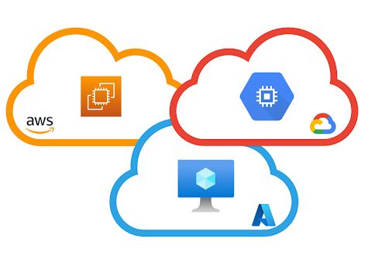
On-Demand Instances

Slide 24
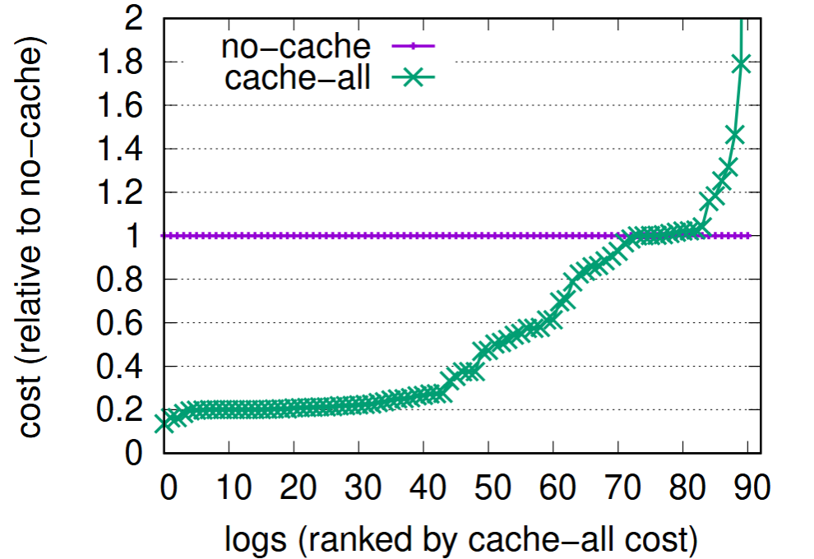
Can Paying for Storage Beat Free Networking in Cloud Bursting?
Absolutely
Cache-all is too permissive
Notes:
Tested using a simulation. The simulation is condensed and assumes io-bound and io operations are sequential.
Worth mentioning that the traces are week long. If they were longer, we would ofc see that cache all is bad in more logs...
//todo: replace graph to include only relevant line

Slide 25
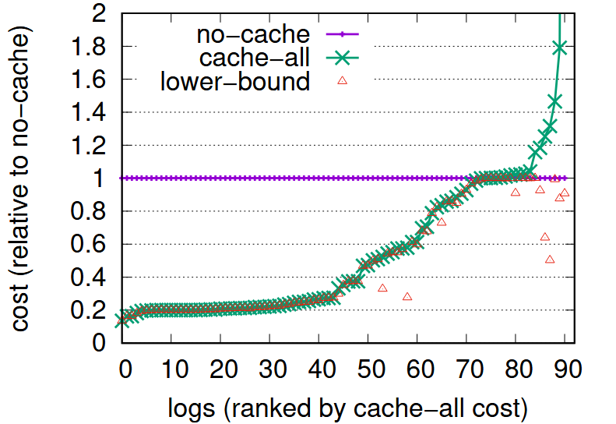
Lower-Bound
Compute time only cost, when objects are cached after first read

Slide 26
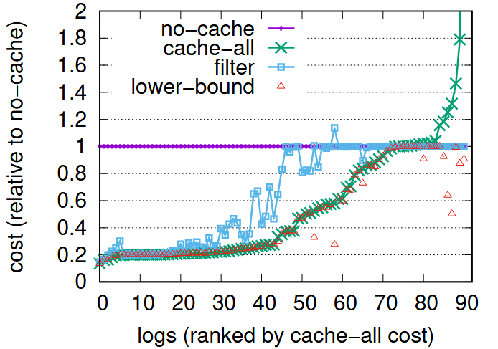
Filter Based Policy
Cache object only after X reads (e.g. 8)
Problem: X object misses → compute time cost

Slide 27


TTL (Time-To-Leave) Based Policy
Capping Worst Case Cost Overhead
(storage $ = remote read $)
ttl
20%
5%
100%
public cloud
For 500KB object:
ttl 100% = ~5 days
ttl 20% = ~day
ttl 5% = ~6 hours
Job 5
Obj 1

Slide 28
Cost Optimization Problem
(storage $ = remote read $)
ttl
20%
5%
100%
  ☺ storage $
  ☹ cache misses
  ☹ storage $
  ☺ cache misses

Slide 29
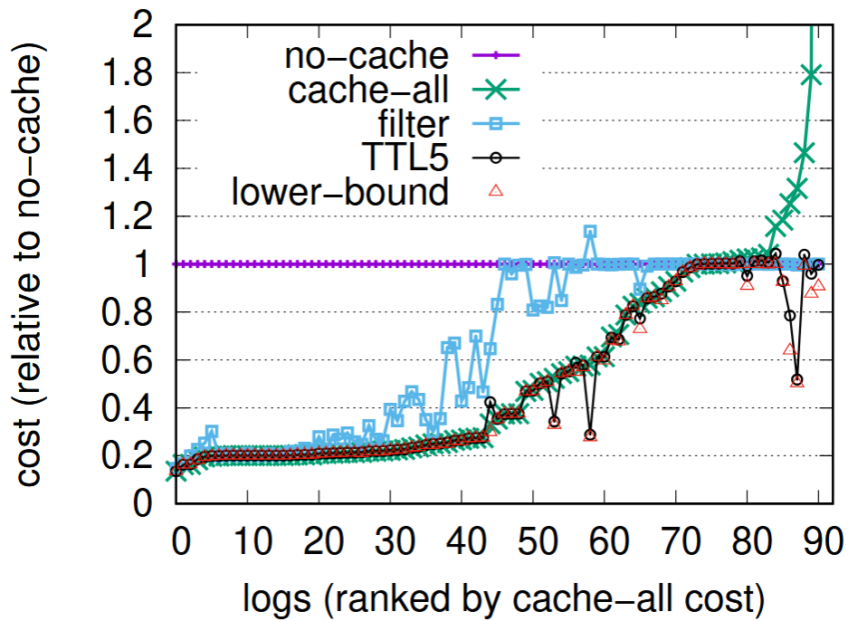
TTL-based Policy
Notes:
for most reads in most logs, small ttls are enough, as storage is much cheaper then cpu and the time between access is not too long

Slide 30
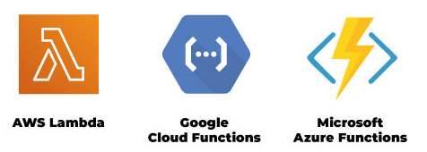
Serverless

Slide 31
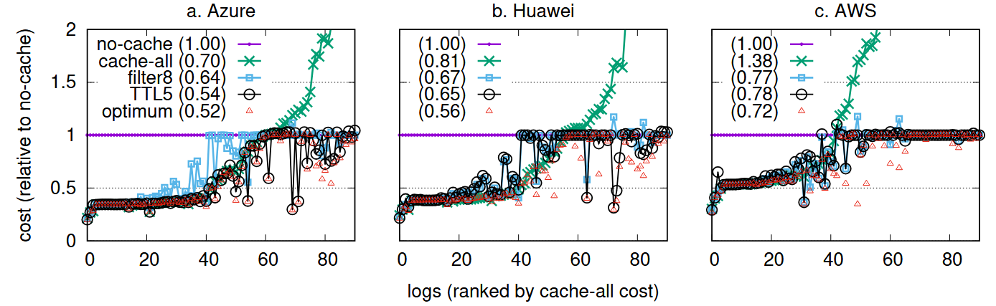
Serverless

Slide 32
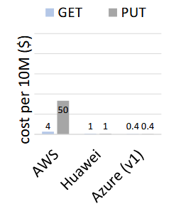
Per Request Costs
If object PUT cost high → TTL can’t cap cache cost
→ Fallback to filter policy

Slide 33
Utilizing Different Storage Services
Multiple cloud storage services
Differ in cost & performance
slow
S3
cheap
S3 Express
fast
expansive
ElastiCache

Slide 34
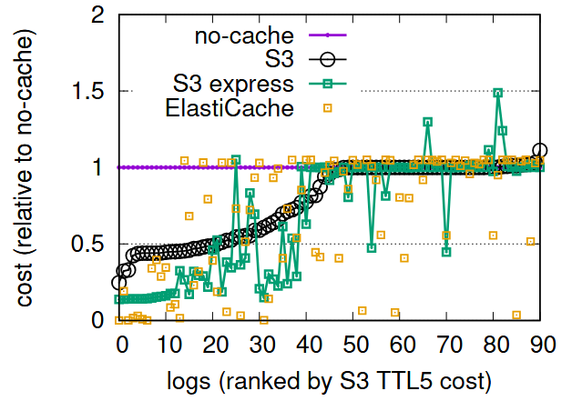
Utilizing Different Storage Services

Slide 35
Utilizing Different Storage Services
Different objects fit different services
Tiered cache may reduce costs for single cloud applications

Slide 36
Summary
In cloud computing caching introduces a cost optimization problem
Unlike traditional caching, cache size is unlimited
We explored several caching policies and showed cost savings for cloud bursting
  Up to 80% savings with TTL policy

Slide 37
Questions?
itamar.gefen@campus.technion.ac.il
Notes:
Add contact details, logos

Slide 38
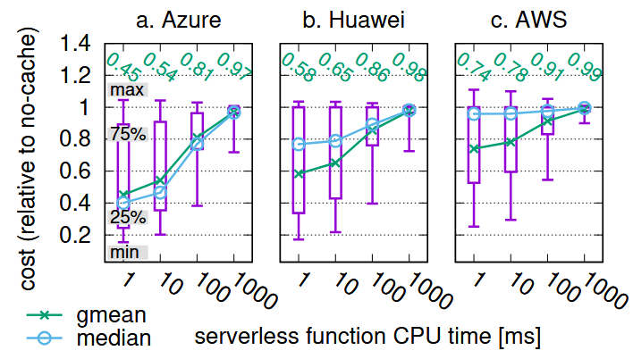
Not Pure IO-Bound
We considered a model in which each object read is followed by an additional CPU period
As can be seen, caching still achieve significant cost savings
However, as the functions are more CPU bound, the savings diminish

Slide 39
Future Work: Dynamic Caching Policies
The caching policies previously discussed are static and do not adapt to client-specific access patterns
Adaptive policies may offer additional benefits, and may be better at utilizing additional storage types

Slide 40
Future Work: Batching
Recall, high object PUT cost (such as in AWS) hurts our cost savings
A possible solution might be to batch writes of multiple objects and write them using a single PUT using a large "container" object
However, this solution has limitations: ranged writes are not supported, and deleting expired objects is harder

